Slide 1


Soldier Health Monitoring System Using Ibm Cloud
Under the Guidelines:
Mrs. Divya Nemuri madam
By
A. Javeed
A. Durga Prasad
A. Keertivardhan
A. Chaitanya Sri Krishna
V. Kesava Pavan Sai

Slide 2
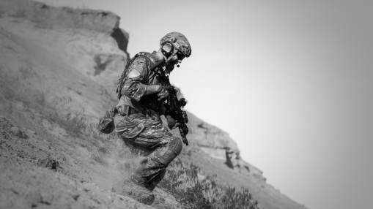
Introduction:
Purpose of this project is to monitor Soldier's health. Because, Soldier health monitoring is very important and essential one.
while soldiers are staying in different environment conditions and in different locations, Due to environmental conditions like extreme cold areas, extreme hot areas and due to all this climate changes soldier health may be affected.
with the help of this project, we're also able to know the location of the soldier so it is a very useful project to track the soldier's location and we're also able to give him the proper medication while he is not filling healthy.

Slide 3
What is the reason behind this project ?
The main reason is we are unable to know the health condition of a soldier while he is in his duty.
mainly soldiers north side of India, doing their jobs in extreme cold conditions so it is very difficult to monitor the health conditions while they're in duty.
And we are also unable to find the location of the soldier while he is sick in the war are in field work.

Slide 4
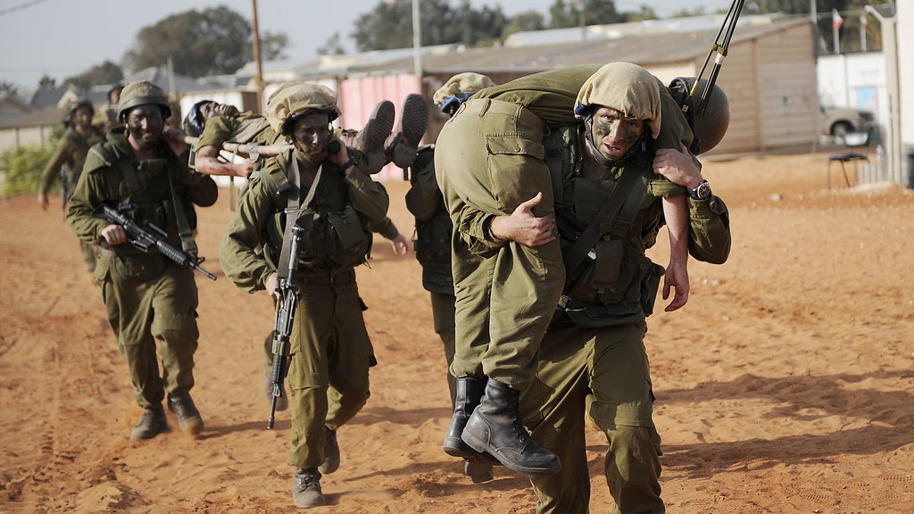
Our SOLUTIONs to the problems
Our solution is the perfect solution to overcome this type of existing problems. Our solution is to locate the area of the soldier by using location sensor.
We also measure temperature and pulse rate of the soldier regularly, so, when we are able to know that soldier pulse rate and temperature, we are able to know health of the soldier regularly.
When soldier health condition is critical, we immediately trace his location with the help of location sensing element and we able to find a soldier and we're able to give him perfect medication.

Slide 5
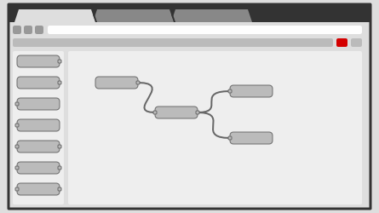
How we are doing this project ?
In this project we are going to build soldiers health monitoring system by the use of IBM cloud services.
We created virtual IOT device in the IBM cloud and we also used node red services in the IBM cloud.
To build our project and we also used IBM Watson services to vary the inputs of our device virtually such as pulse rate, body temperature by signing into an account by using the ID of the device.
We also determine the location of the soldier by using location sensors, and we will observe the result in node red services.

Slide 6
Block Diagram:
Finding location
of the soldier
Checking the health
of the soldier
know the temperature
and pulse rate
Taking the immediate
Actions, based on health condition

Slide 7
IMPLEMENTATION of our project
In our project firstly we created the virtual IOT device in the IBM cloud services.
We also used the Node Red service to connect the required nodes to build our project.
Then we also get the location link to locate the soldiers position and we added it as a node in the node red services.
We runed the python code which is written in the Python Idle to measure pulse rate and temperature of the soldier.
we varied the temperature and pulse rate of the soldier virtually in the IBM Watson Service.

Slide 8

So, Finally
So, finally we are able to find the location of the soldier and we’re also able to observe the pulse rate and temperature of the soldier by varying the values in the IBM Watson Service Virtually.

Slide 9


Flow chart:
building soldier health monitoring system
IBM cloud
IBM Watson Services
Io T device
Noed Red Services
Result
(Location, pulse rate, temper)
Python Idle

Slide 10
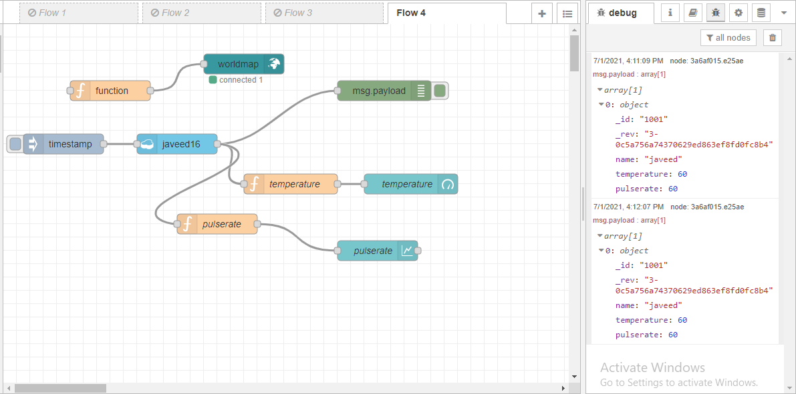
Result:

Slide 11
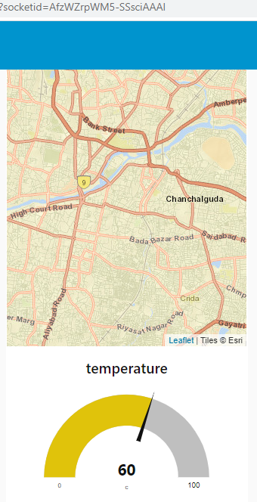
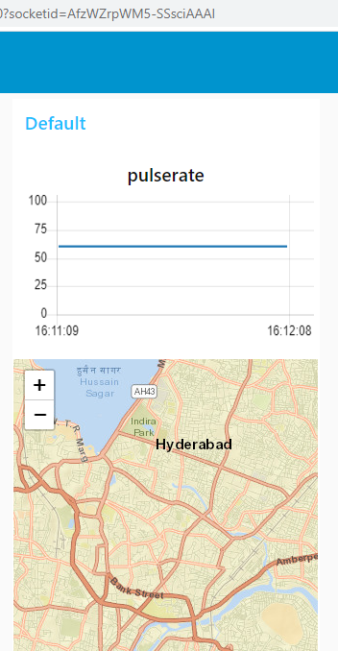

Slide 12

Applications:
The main application of this project is to check the health and location of the soldier.
We can also use it in navy applications.
We can also use this project to check normal patients' health.
We can also use this for wildlife officers to check health and location.

Slide 13
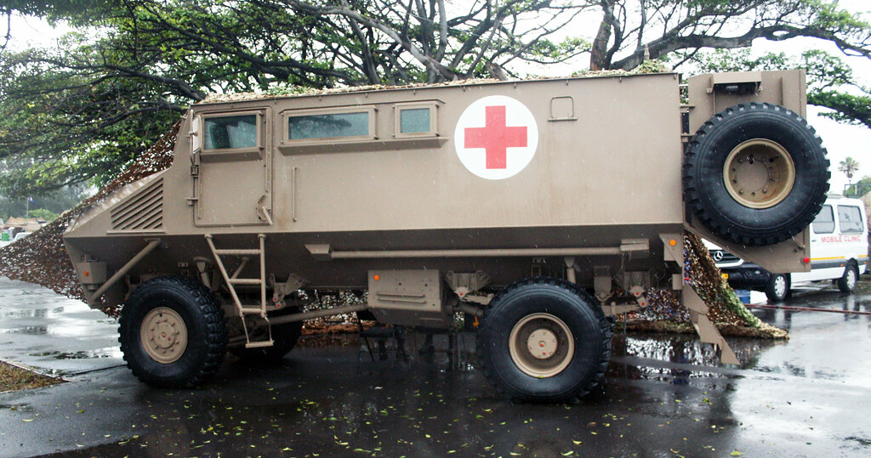
Advantage:
The first advantage, we can find the location of the soldiers.
We can check the health conditions of the soldiers regularly.
We can give proper medication at once while soldiers health is not good
We can know the health condition when he is in the war.
This Photo by Unknown author is licensed under CC BY-SA.

Slide 14

DISAdvantage:
We can't expect same results in hardware development.
Our device may get damaged.
If our cloud system is hacked, soldiers' life will be in risk.
We may also get network disturbance in finding locations of the soldier

Slide 15

CONCLUSION:
We are able to developed soldier health monitoring system using IBM cloud services, we are able to know soldier pulse rate, temperature and location.

